Slide 1
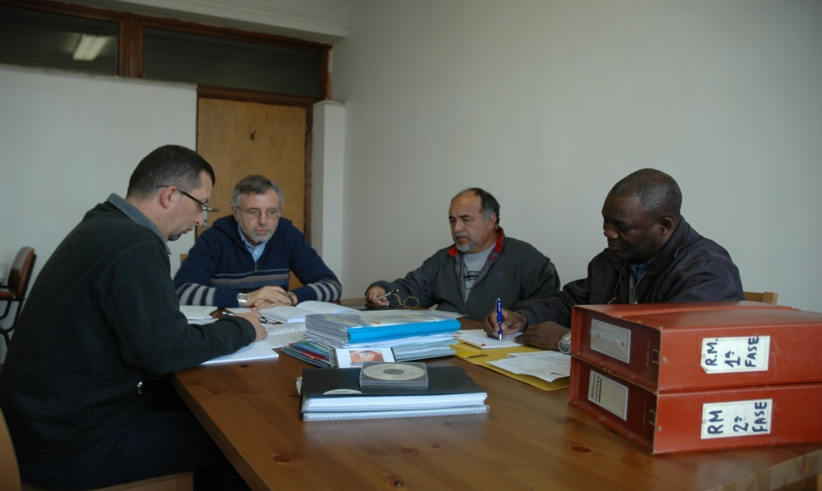
The journey to the RATIO MISSIONIS (2011-2012)
(how the present document came to be written)

Slide 2
The starting point
Chapter 2009 (CA 11.1): a systematic re-reading of the material in order to reach a theological reflection on Mission and Comboni methodology
Superior General’s letter nominating a Commission for the RM: that the RM become a means of fidelity to the charism and new missionary commitment

Slide 3
FIRST PART: systematic reading of the material, i.e. what the confreres had been saying (2005-2008)
What to read: General and Continental synthesis and some Provincial synthesis
A first reading according to three criteria: how the confreres have lived the process of the RM, theological reflection, elements of Comboni methodology

Slide 4
Relevant themes after the first reading of the material:
Attitudes and positive experiences in the process of the RM
Theological spheres
Elements of Comboni identity
Places and elements of Comboni Missionary Pastoral approaches

Slide 5
re-reading of the material according to the relevant themes and writing of the first part of the document (with INSERTS for open and debatable questions)

Slide 6
SECOND PART: theological reflection
How to do it? Which method to adopt? Which ways to follow?
Identification of a method: Bevans-Schroeder and Walls speak of ‘constants’ e ‘continuities’ that the Commission interpreted as unchanging attitudes and dimensions in the various missionary contexts

Slide 7
2) Identification of the models of the Church, Christological models and models of mission underlying our missionary experience
4 blocks of questions for reflection
THEOLOGICAL REFLECTION
1) Identification and elaboration of 8 ‘constants’: discernment, dialogue, context, collaboration, participation, prophecy, presence/martyrdom, communion
for each constant:
a) Where the RM mentions it
b) Theological dimensions
c) Practical implications

Slide 8
The challenge for the provinces
To make the RM known to the confreres and contextualise it in a ‘Directory of Evangelisation’

Slide 9
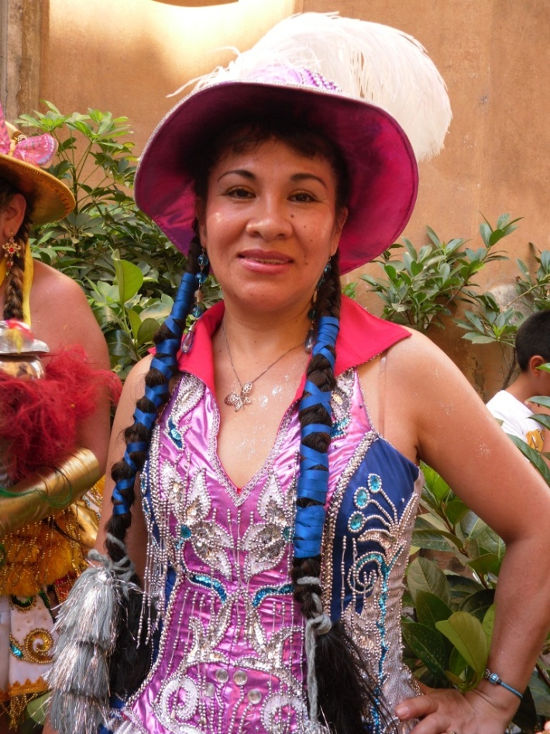
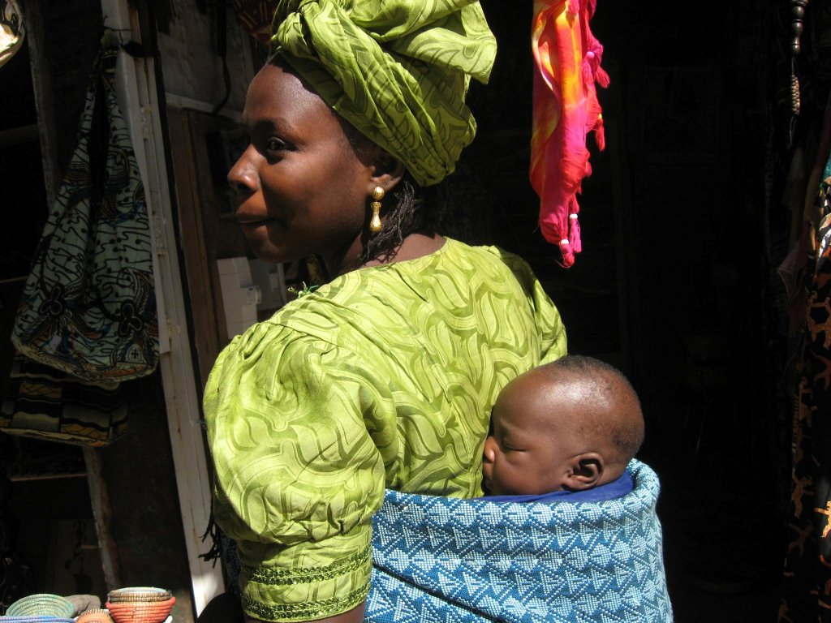
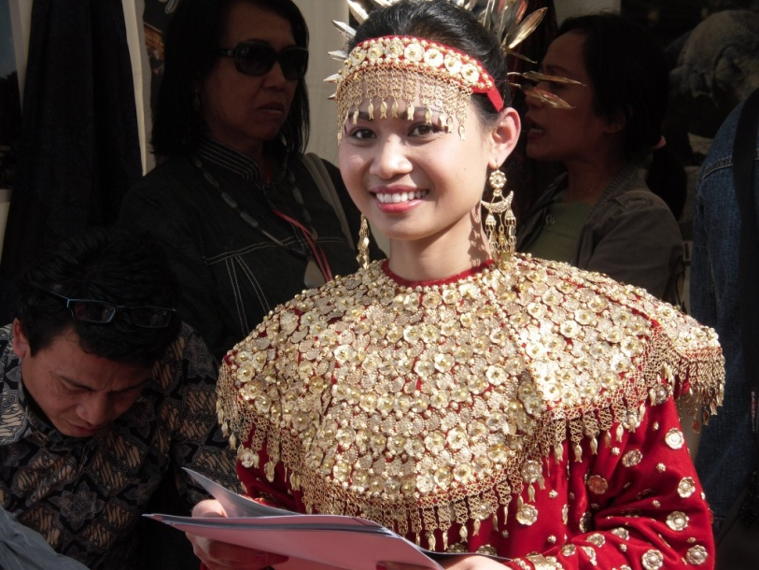
«The end is our beginning»

